Slide 1

ML-FIN-2026-v4 • Capstone Project
Stocks AI: Multi-Day Stock Return Prediction
An end-to-end regression framework for multi-day returns forecasting using technical features and ensemble learning techniques.
GROUP 5
Qusai Rahhal, Ghufran Almeqbel, Raghad Al-Hindi, Tasneem Mazrawe,Sajeda Ibrahem

Slide 2
Problem Statement & Market Challenges
Overcoming stochastic market noise and subjectivity through structured predictive modeling.
Stochastic Noise
Regime Shifts
Overfitting Risk
Market volatility driven by economic events creates extreme noise in daily asset valuations.
Non-stationary financial distributions drift over time, breaking classical statistical assumptions.
Naive models overfit to spurious historical correlations that fail in real-world trading.

Slide 3
Project Roadmap
The 4-step engineering workflow from raw historical data to robust prediction.
01
02
03
04
Data Cleaning & EDA
Feature Engineering
Model Benchmarking
Time-Series Validation
Handling missing rows, date conversions, and exploratory visualizations.
Computing RSI, MACD, Bollinger Bands, ATR, and technical indicators.
Training and evaluating Ridge, Random Forest, XGBoost, and CatBoost.
Predicting 3-day returns via TimeSeriesSplit without data leakage.

Slide 4
Core Dataset & Architecture
Multi-asset historical time-series spanning 5 years of daily trading data.
Column Name | Data Type | Description
datetime | datetime64 | Chronological trading timestamp
Name | object (categorical) | Individual asset ticker symbol
Open / High / Low / Close | float64 | Daily OHLC price action markers
Volume | int64 | Total daily shares traded quantity

Slide 5
Data Cleaning & Outlier Strategy
Ensuring data integrity while preserving genuine financial market signals.
Datetime Parsing
Missing Value Treatment
Outlier Preservation
Converted date columns from string/object format to proper pandas datetime64 to establish a chronological index.
Identified a minimal number of null entries and safely dropped those rows, ensuring zero negative impact on predictions.
Deliberately avoided IQR clipping; extreme market spikes reflect genuine volatility regime shifts and tail risks.

Slide 6
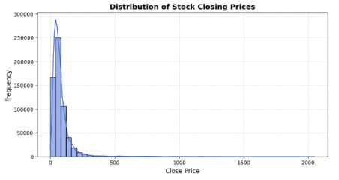
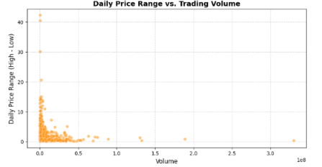
Visualizing distribution skewness, volume-price links, and asset liquidity profiles.
Exploratory Data Analysis (EDA)
1. Close Price Distribution (Right-skewed) | 2. Volume vs. Price Range Scatter
1. Distribution of Stock Closing Prices: Right-skewed price densities.
2. Daily Price Range vs. Trading Volume: Sampled scatter analysis showing spread expansion during high-volume sessions.

Slide 7
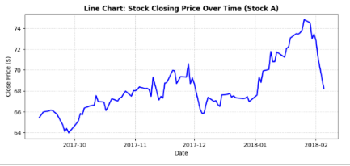
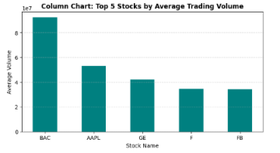
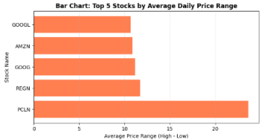
Visualizing distribution skewness, volume-price links, and asset liquidity profiles.
Exploratory Data Analysis (EDA)
3.closing price over time| 4. Top 5 Stocks by Volume (e.g., BAC) | 5. Top 5 Stocks by Price Range (e.g., PCLN)
3. Stock Closing Price Over Time (Stock A): Tracking long-term price action and cyclical trends over the last 100 trading days.
4. Top 5 Stocks by Average Trading Volume: Isolating high-liquidity market-cap equities (e.g., BAC, AAPL).
5. Top 5 Stocks by Average Daily Price Range: Highlighting high-volatility assets (e.g., PCLN, REGN).

Slide 8
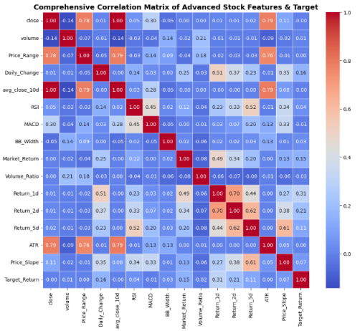
Feature Correlation Matrix
Evaluating statistical linear dependencies between raw features prior to engineering.
Visualizes multicollinearity and initial feature interactions before building advanced technical indicators.
Comprehensive Correlation Heatmap: Evaluates statistical linear dependencies between raw features prior to advanced feature engineering.
Matrix Insights: Visualizes multicollinearity and initial feature interactions before building advanced indicators.

Slide 9
Feature Engineering: Raw & Price Action
Extracting fundamental price action and trend characteristics.
Name_Encoded
Price_Range & Daily_Change
avg_close_10d & trend_10d
Label-encoded categorical ticker symbol identifying individual stock profiles.
Daily spread (High - Low) and percentage price change from the previous close.
10-day moving average and short-term directional trend indicators.

Slide 10
Feature Engineering: Technical Indicators
Capturing momentum, volatility, and trend strength.
RSI (14-Day)
MACD
BB_Width
ATR & Price_Slope
Momentum oscillator measuring overbought/oversold levels.
Trend-following momentum difference between EMAs.
Bollinger Bands width capturing volatility expansion/contraction.
Average True Range and 5-day regression slope for trend strength.

Slide 11
Feature Engineering: Returns & Context
Quantifying historical persistence and market positioning.
Lagged Returns
Market Return & API Integration
Price_to_High_20d
Return_1d, Return_2d, and Return_5d capturing short-term historical return persistence.
Programmatically fetched benchmark index data via yfinance API matching exact timeframes to compute Market_Return.
Relative price positioning metric against the 20-day high threshold.

Slide 12
Preprocessing & TimeSeriesSplit
Rigorous feature scaling and prevention of data leakage.
Standard Scaling
TimeSeriesSplit Validation
Normalized all numeric features to a zero-mean distribution using `StandardScaler`.
Forward-chaining time cross-validation used strictly to prevent Data Leakage. Models train on past data and predict future unseen data.

Slide 13
Model Zoo & Benchmarking
Evaluated regression algorithms for multi-day return forecasting.
Ridge Regression
Random Forest
XGBoost
CatBoost
L2 regularized linear baseline model for comparative benchmarking.
Bagging decision tree ensemble mitigating variance and noise.
Gradient boosting tree algorithm optimized for performance.
Ordered boosting handling non-linear asset interactions.

Slide 14
Model Performance & Results
Comparative error evaluation across all trained regression models.
Model | MAE (Mean Absolute Error) | RMSE (Root Mean Squared Error)
Random Forest (Winner) | 0.015404 | 0.023091
Ensemble (Voting) | 0.015582 | 0.023269
XGBoost | 0.015714 | 0.023444
CatBoost | 0.015789 | 0.023545
Ridge Regression | 0.016040 | 0.023865

Slide 15
Why Random Forest?
Justifying model superiority and error metric interpretation.
Lowest Error Metrics
Variance & Noise Control
Metric Meaning
Achieved superior MAE (0.0154) and RMSE (0.0231) across time-series validation folds.
Bagging multiple decision trees effectively dampens extreme market noise without overfitting.
MAE of ~1.5% deviation from actual returns provides highly reliable directional trading signals.

Slide 16
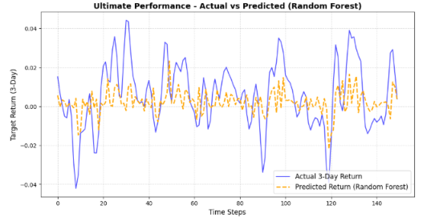
Prediction Fitting: Actual vs. Predicted
Visualizing model tracking against real market movement.
Trend Tracking: Model accurately captures directional momentum switches across time horizons.
Balanced Generalization: Predictions follow market peaks and troughs flexibly without falling into rigid static lines or overfitted memorization.
Model accurately captures directional momentum switches and market peaks/troughs flexibly without overfitting.

Slide 17
Conclusion & Future Enhancements
Project wrap-up and next steps for quantitative advancement.
Key Takeaways
Future Work
Advanced feature engineering and strict TimeSeriesSplit successfully built a robust quantitative return predictor.
Integrate NLP sentiment analysis on financial news and explore deep learning architectures (LSTM / Transformers).

Slide 18
Thank You!
Questions & Answers Session
Group 5 • Stocks AI Capstone Project

